Slide 2
Neutral Electrolyzed Oxidizing Water (NEOW)
Biocide New Generation
NEOW is oxidized ionized water from
dissolved salt (NaCl)
Electro-oxidized water produces chloride, sodium hypochlorite and residual chlorine.

Slide 3
How does NEOW work?
In the physical and chemical action of NEOW is expected that microorganisms will not become resistant.
Natural biosides bind to the surrounding electrons and reduce the stability of the bacterial wall by forming microelectrolysis and hyper-oxide ions (Pintaric et al. 2015a).

Slide 12
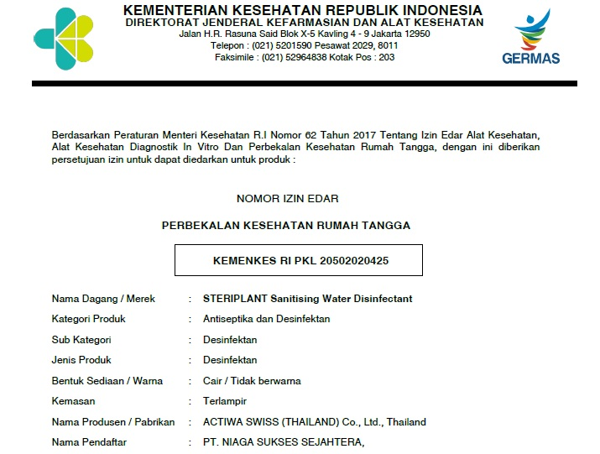

Slide 13
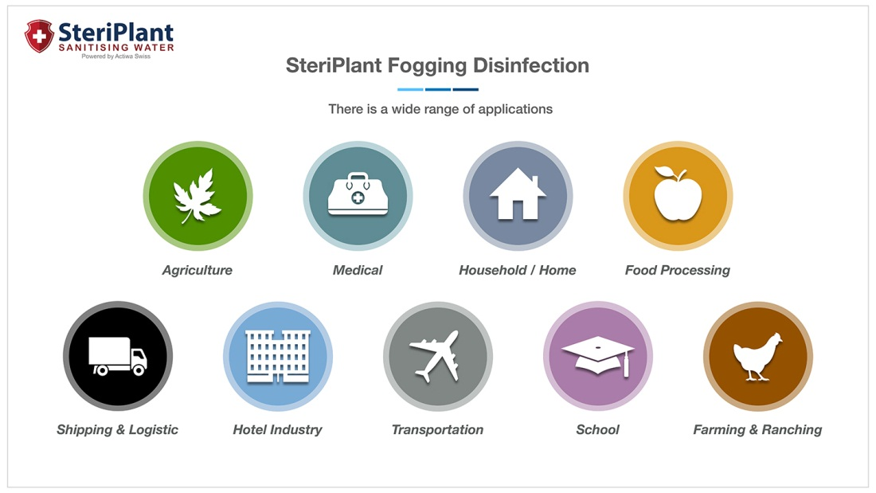

Slide 15
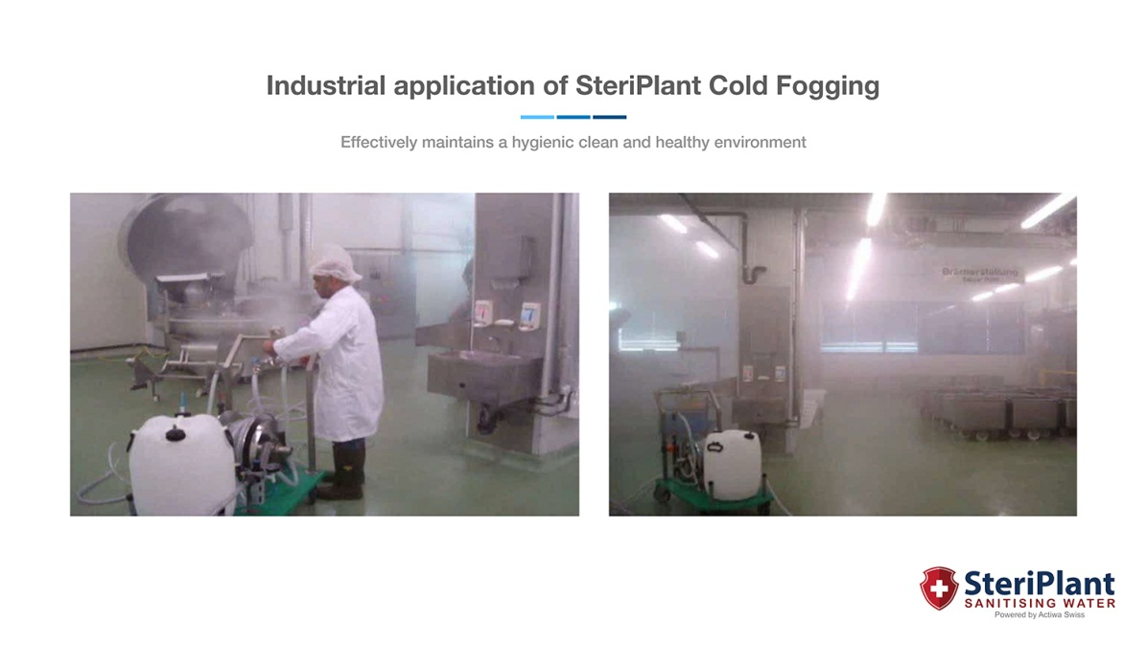

Slide 18
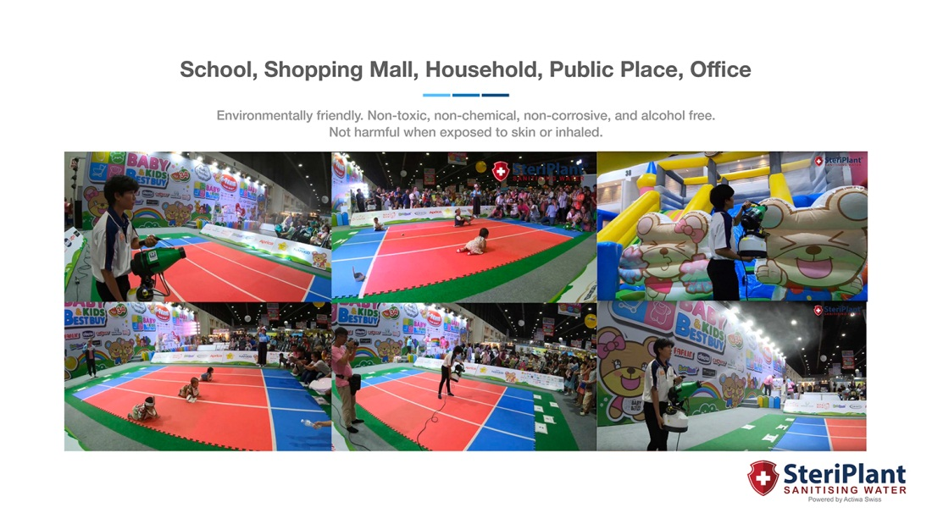

Slide 19
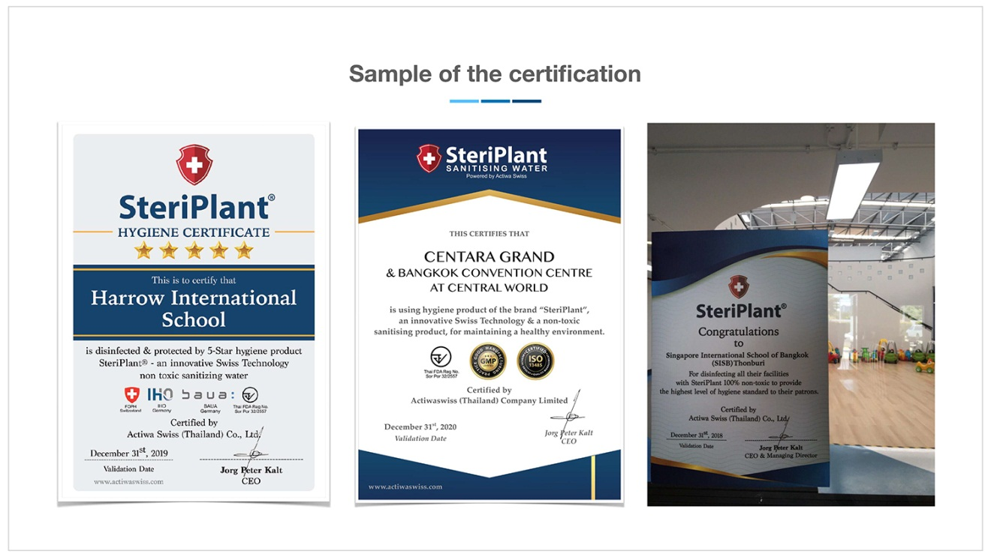

Slide 20
Thank you

